Slide 1
ChIP-Seq Data Analysis 1
Lauren Vanderlinden
BIOS 6660
Spring 2019

Slide 2
Overview From Last Time
Walked through RNA-seq pre-processing on yampa
Many independent scripts
Good to have a main document which shows which scripts you used

Slide 3
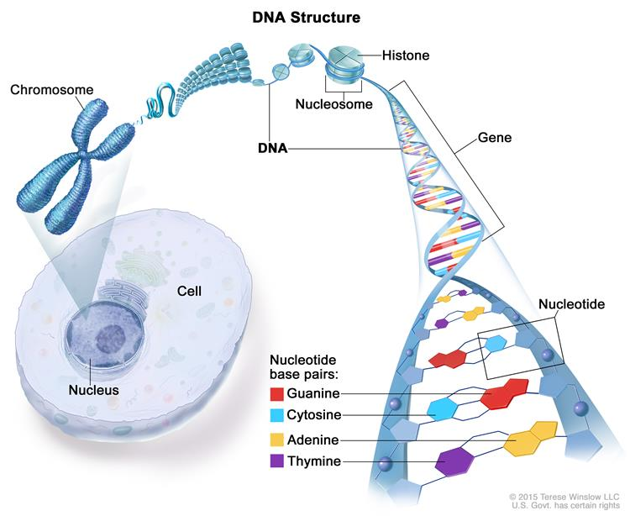
Chromosomes
How DNA is stored in the cell
>3 billion bases, need to fit in a small space
DNA is wrapped around proteins called histones which coil into chromosomes
Chromatin is the DNA and proteins making up the chromosomes
Source: National Cancer Institute

Slide 4
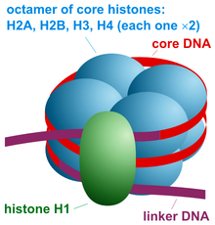
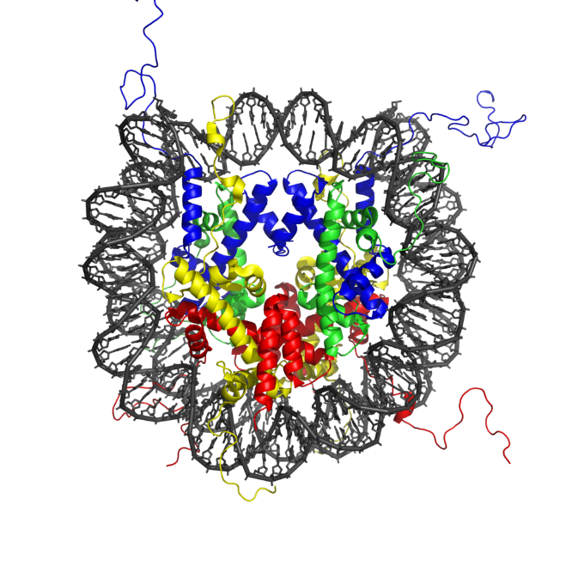
Nucleosome
Basic unit of packaging
Consists of DNA wrapped around a core of 8 histone proteins
Compared to a spool
Nucleosome positions in the genome are not random
Determines the accessibility of the DNA to regulatory proteins
Source: Wikipedia

Slide 5
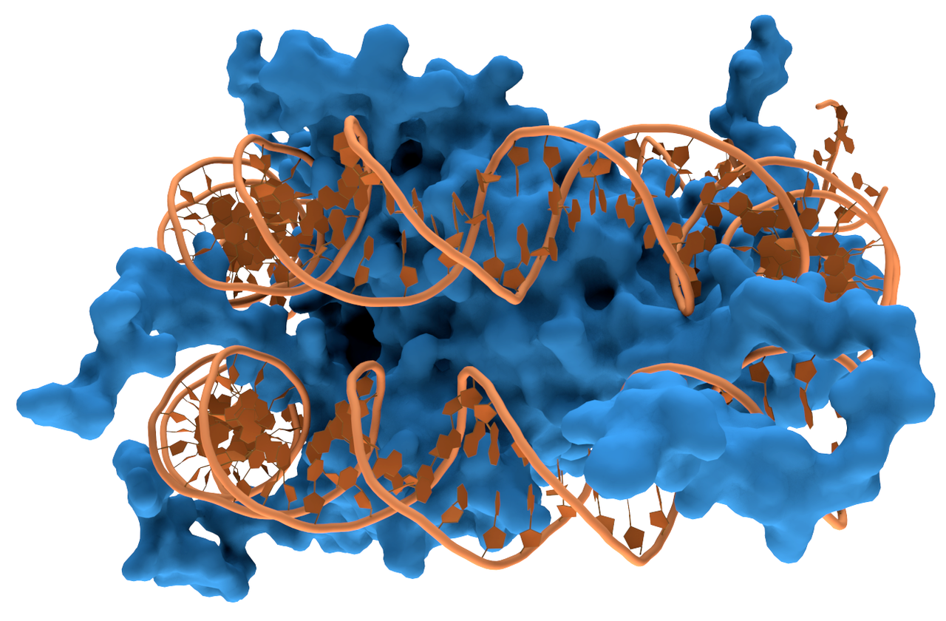
DNA-Protein Physical Interaction
Many types of DNA-binding proteins
Transcription Factors
Regulate gene expression
Polymerases
Enzymes synthesizes long chains of polymers or nucleic acids
Nucleases
Enzyme which can cleave DNA
Histones
Chromosome packaging
For ChIP-Seq we will be interested in transcription factors and histone binding
Source: wikipedia
A histone is shown in blue and DNA in gold
3D structure is very complex

Slide 6
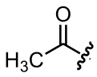
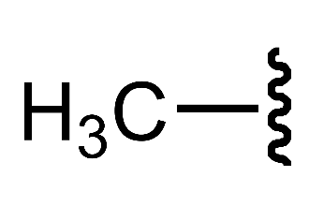
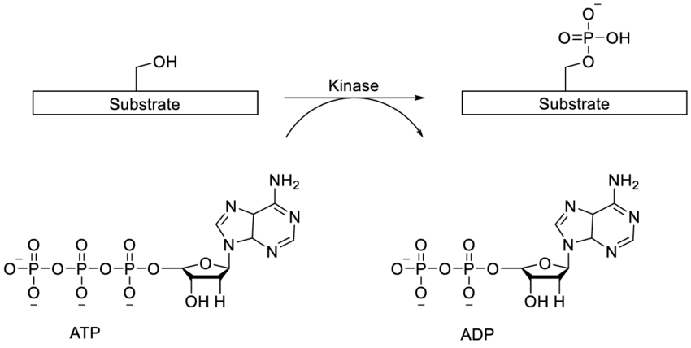
Chromatin Remodeling
Acetyl group:
Dynamic modification of chromatin architecture to allow access of condensed genomic DNA
Allows regulatory transcription machinery proteins to access DNA
regulates gene expression
2 main methods:
Covalent histone modifications by specific enzymes
Histone acetyltransferases (HATs)
Deacetylases
Methyltransferases
Kinases
ATP-dependent chromatin remodeling complexes which either move, eject or restructure nucleosomes
Methyl group:
Kinases:
Source: Wikipedia

Slide 7
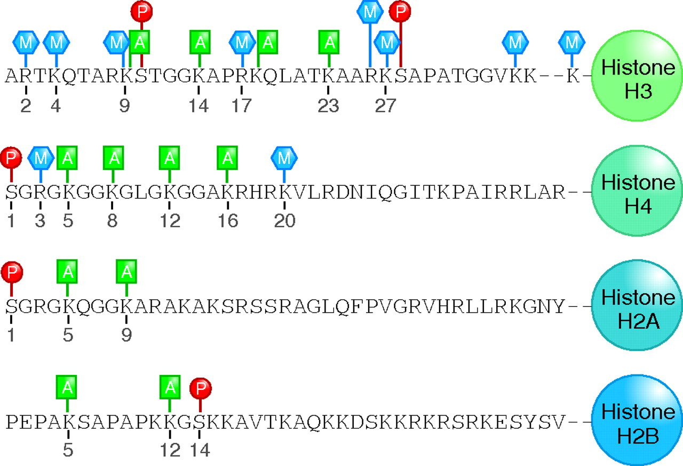
Histone Modifications
mono-, di-, or trimethylation (M) at arginine or lysine residues
acetylation (A) at lysine residues
phosphorylation (P) at serine residues.
Some amino acids, such as lysine 9 of histone H3, can be subject to either acetylation or methylation, but not both
H3 trimethyl K4 is popular to look at
Source: Dressler et al, 2008

Slide 8
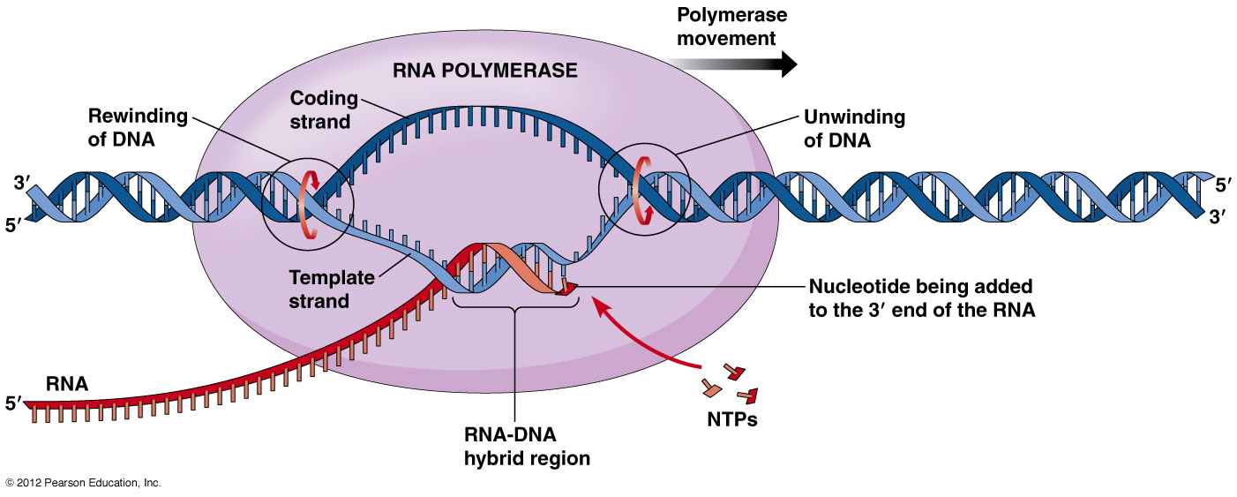
Transcription
DNA
RNA
RNA Polymerase needs to attach to DNA
But how does it know where to go and bind to?
Promoter regions
≈100–1,000 bp long right before the transcription start site (TSS)
TATA box
Enhancer Regions
≈ 50–1,500 bp long
Can be located up to 1 Mb away
always cis-acting
Source: Pearson Education

Slide 9
Transcription Factors
Basal, or general, transcription factors are necessary for RNA polymerase to function at a site of transcription in eukaryotes
Considered the most basic set of proteins needed to activate gene transcription
Bind to either enhancer or promoter regions of DNA adjacent to the genes that they regulate
Can cause gene to be either up- or down- regulated
Many mechanisms:
Stabilize or block the binding of RNA polymerase to DNA
Catalyze acetylation or deacetylation of histones
Recruit coactivator or corepressor proteins to the transcription factor DNA complex

Slide 10
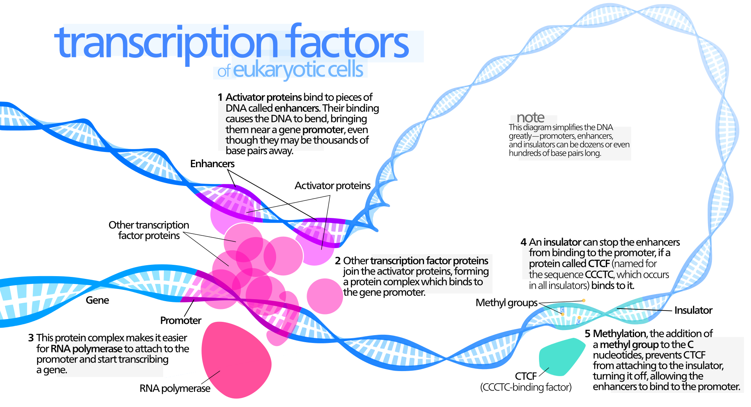
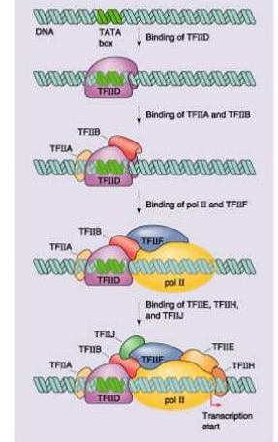
Example of Basal TF
Source: wikipedia
Source: slideServe

Slide 11

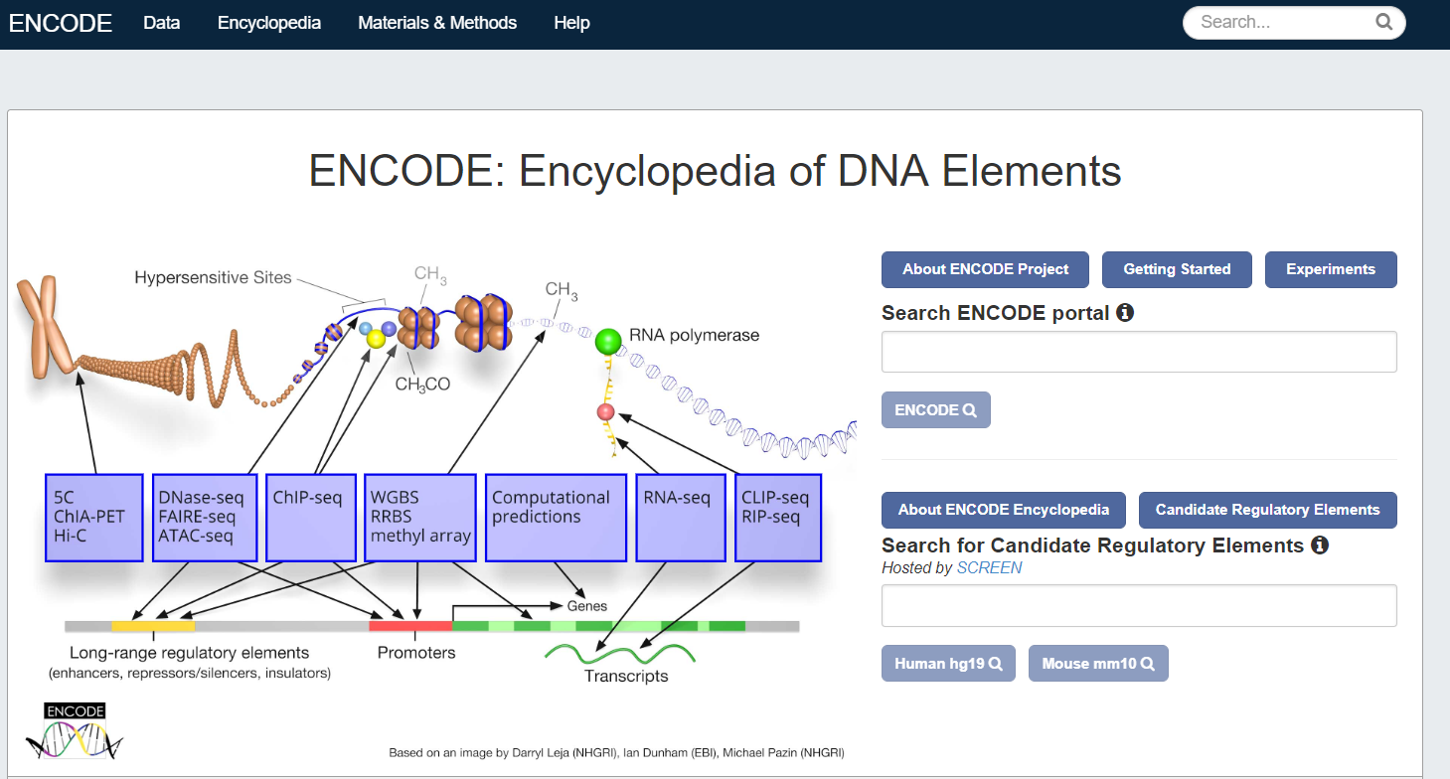
ENCODE
https://www.encodeproject.org/

Slide 12
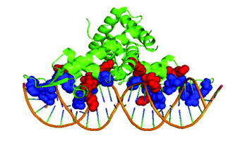
ChIP-Seq
Chromatin immunoprecipitation (ChIP)
DNA sequencing (Seq)
Goal: identify the binding sites of DNA-associated proteins.
Source: Shen et al, 2017

Slide 13
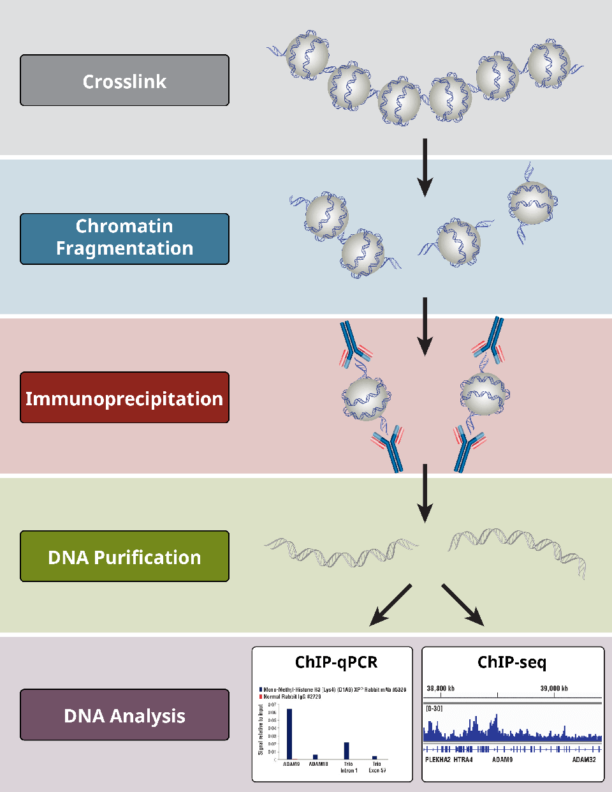
Chromatin Immunoprecipitation (Steps 1&2)
Crosslink DNA to protein so stays stable OR Native Approach
Crosslink using formaldehyde or UV light
Use crosslinking when looking at TF
Use native state when looking at histone modifications
Fragment
Sonication will shear chromatin
Source: Cell Signaling Technologies

Slide 14
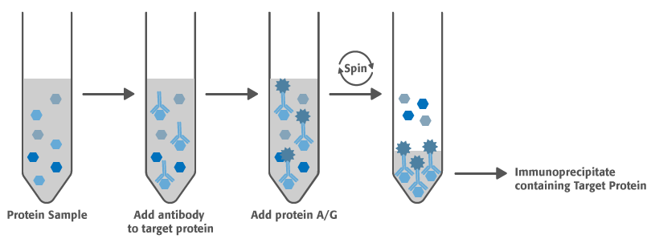
Chromatin Immunoprecipitation (Steps 3&4)
Immunoprecipitation
Use an antibody to select protein of interest
Purify DNA
Cross-link reversal
Purify
Source: US Biology Life Sciences
Source: Cell Signaling Technologies

Slide 15
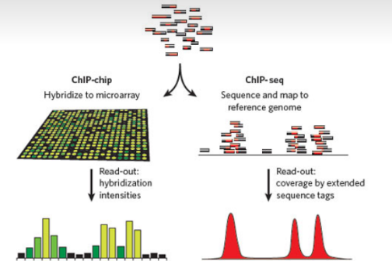
ChIP-Paired With Some DNA Technology
Source: Katerina Kechris
Source: Cell Signaling Technologies

Slide 16
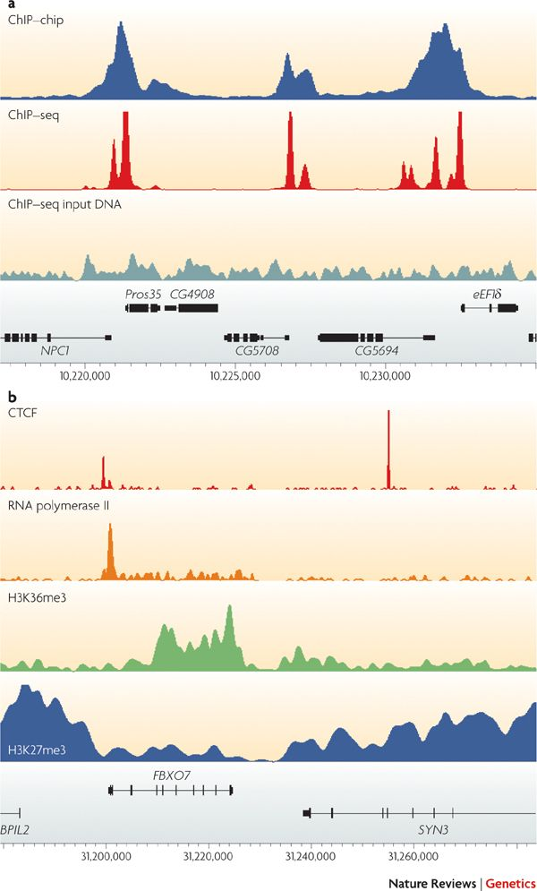
Negative Controls
Sensitivity and specificity of antibody
Found large artifacts
Find peaks in control
Biases:
Shearing of DNA
GC content
Regions of open chromatin
Compare your true ChIP-Seq to a background
Control sample “input” or “IgG”
Sonicated chromatin without immunoprecipitation
IgG: “unspecific” IP
Source: Parker at al, 2009

Slide 17
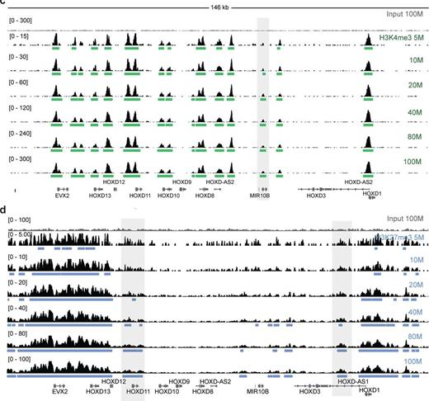
Sequencing & Experimental Design
Platform
Illumina
Fragment Length
25-35 bp common
Depth
40-50 Million
R/CSSP
Power analysis for sequencing depth in ChIP-Seq analysis
Use biological replicates
N=3 for cell lines
Usually use same control
Source: Jung at al, 2014

Slide 18
ChIP-Seq Pre-Processing
Raw Reads
Trim Reads
Peak Calling
Genome Alignment

Slide 19
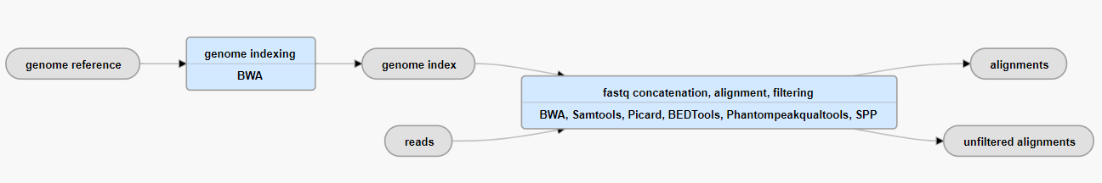
ENCODE Pipeline
QC
Uniquely mapped reads, at most 2 mismatches
>%50 total reads uniquely mappable
>50% reads non-redundant
Non-Redundant Fraction (NRF)
Need NRF > 0.8 for 10M reads
Wide distribution across genome, low GC bias, etc.
Raw reads in FASTQ format
ENCODE recommends using BWA
Unspliced aligner (no gaps allowed)
Okay because we are dealing with DNA
Take the aligned bam file to a peak calling algorithm

Slide 20
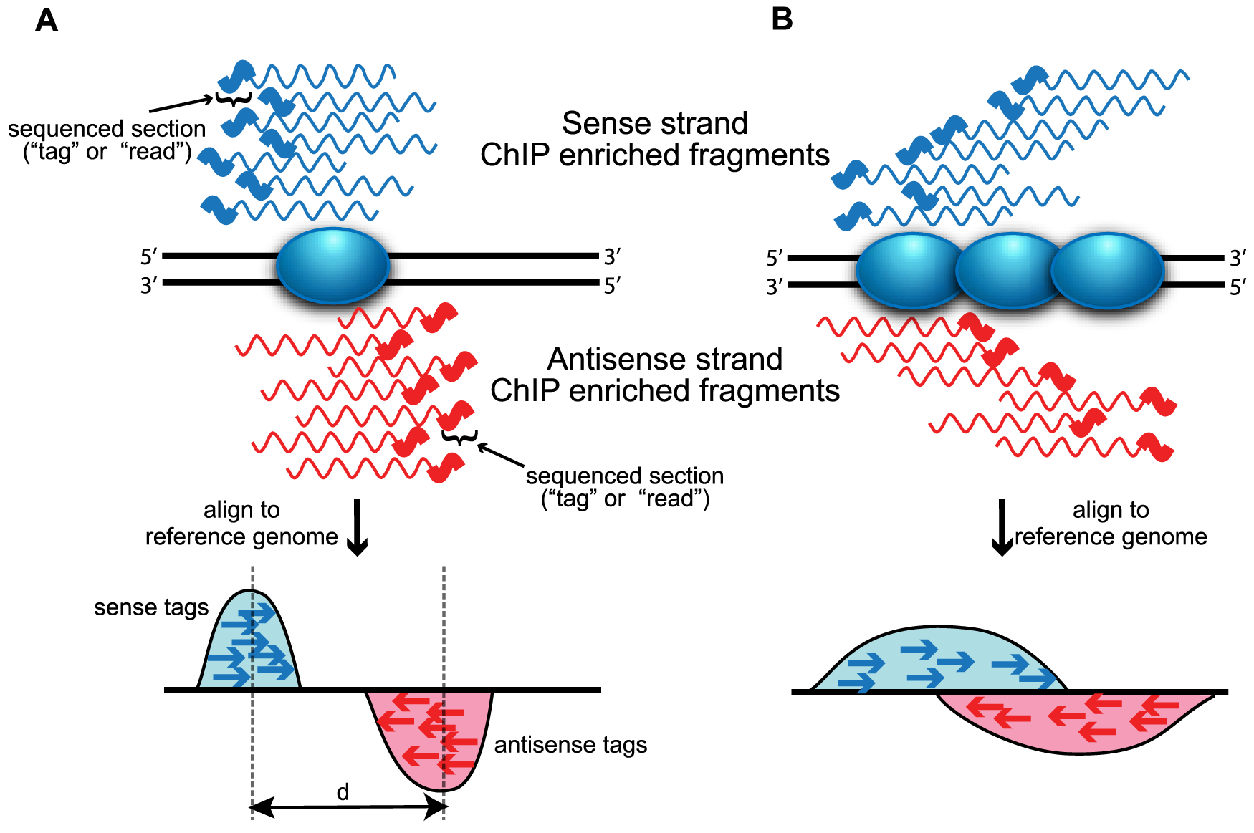
Peak Calling
What area of the genome do we say is interacting/binding with protein?
Since we have DNA, we have 2 strands
Sense
Antisense
A) TF B) Histone
Source: Wilbanks et al, 2010

Slide 21
Histone vs TF Peaks
Transcription factor peaks are sharper
Transcription factor DNA binding sites are typically 10 nt long
Histone peaks typically ~4x times length as TF peaks
Use different peak calling algorithms based on type of ChIP you used
Source: Parker at al, 2009

Slide 22
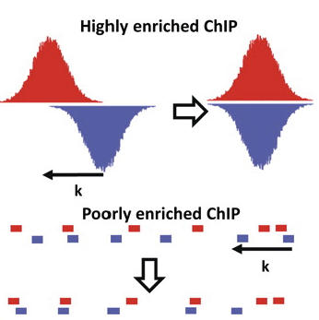
Read Shifting
Offset in forward or reverse strand reads
Majority ChIP-Seq single-end sequencing
Reads align to either the sense/antisense strands and the 3’ or 5’ extremes of the DNA fragments pulled down.
The reads are shifted and the data from both strands combined to determine the most likely bases involved in protein binding.
How big a "shift" is determined by the fragment size generated in the ChIP-seq library preparation
Estimate from sequence data
Determine empirically
+ Strand
- Strand
Source: Indiana University

Slide 23
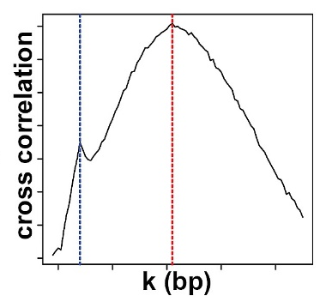
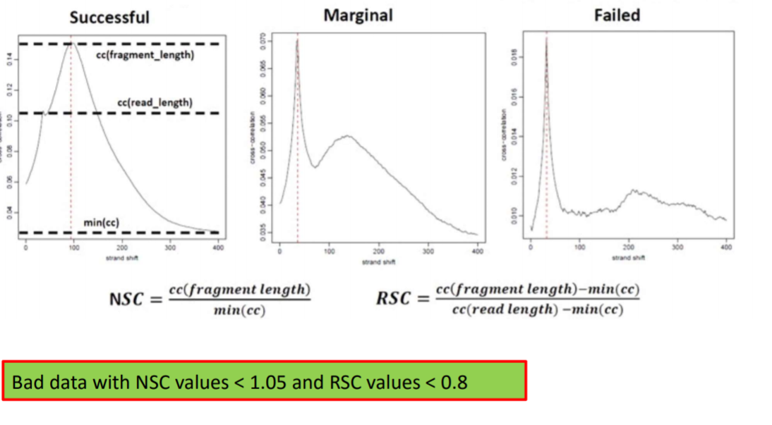
Cross-Correlation
Pearson correlation between positive and negative strand profiles at different strand shift distances, k.
Cross-correlation peaks at 2 places:
Read length (blue)
Average fragment length (red)
Source: Bailey et al, 2013
Source: Cornell University

Slide 24
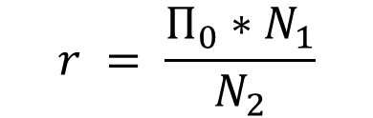
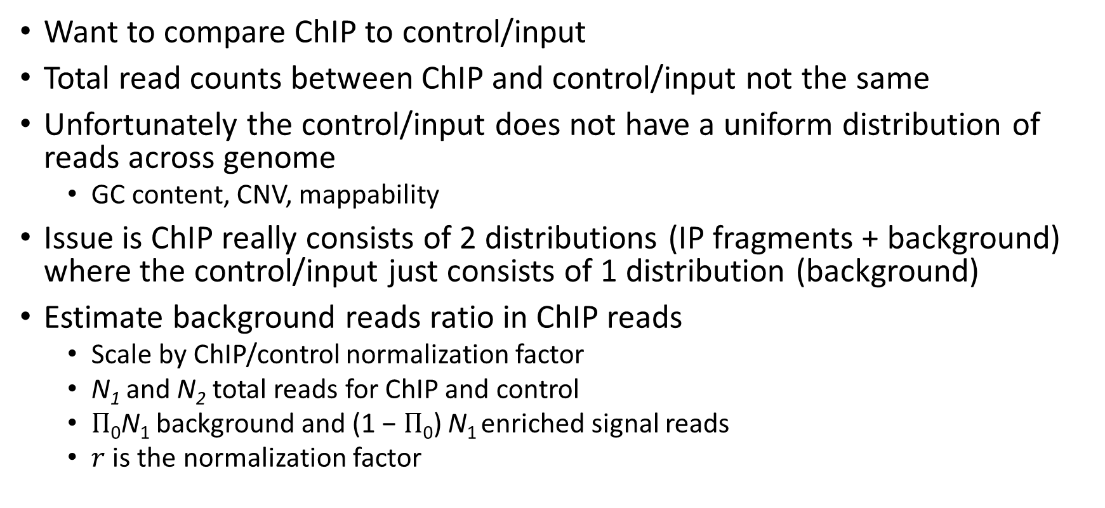
Normalization
Want to compare ChIP to control/input
Total read counts between ChIP and control/input not the same
Unfortunately the control/input does not have a uniform distribution of reads across genome
GC content, CNV, mappability
Issue is ChIP really consists of 2 distributions (IP fragments + background) where the control/input just consists of 1 distribution (background)
Estimate background reads ratio in ChIP reads
Scale by ChIP/control normalization factor
N₁ and N₂ total reads for ChIP and control
$Π$₀N₁ background and (1 − $Π$₀) N₁ enriched signal reads
$r$ is the normalization factor
$$r = \frac{Π_{0}∗N_{1}}{N_{2}}$$

Slide 25
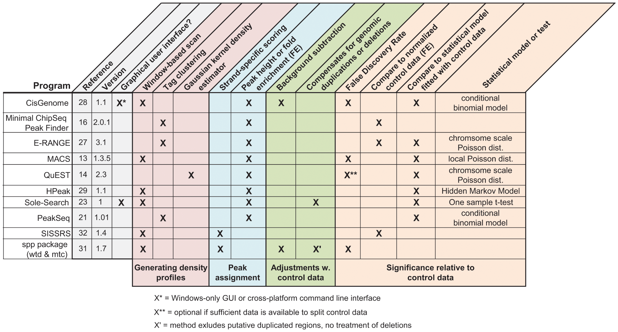
Peak Calling Programs
Within R:
BayesPeak, PICS, MOSAiCS, iSeq, ChIPseqR, CSAR, ChIP-Seq, SPP, NarrowPeaks
Command Line Tools:
CisGenome, E-RANGE, FindPeaks, F-Seq, GLITR, MACS, PeakSeq, QuEST, SICER, SiSSRs, spp, Useq, MUSIC, BCP
The options are endless!
Source: Parker at al, 2009

Slide 26
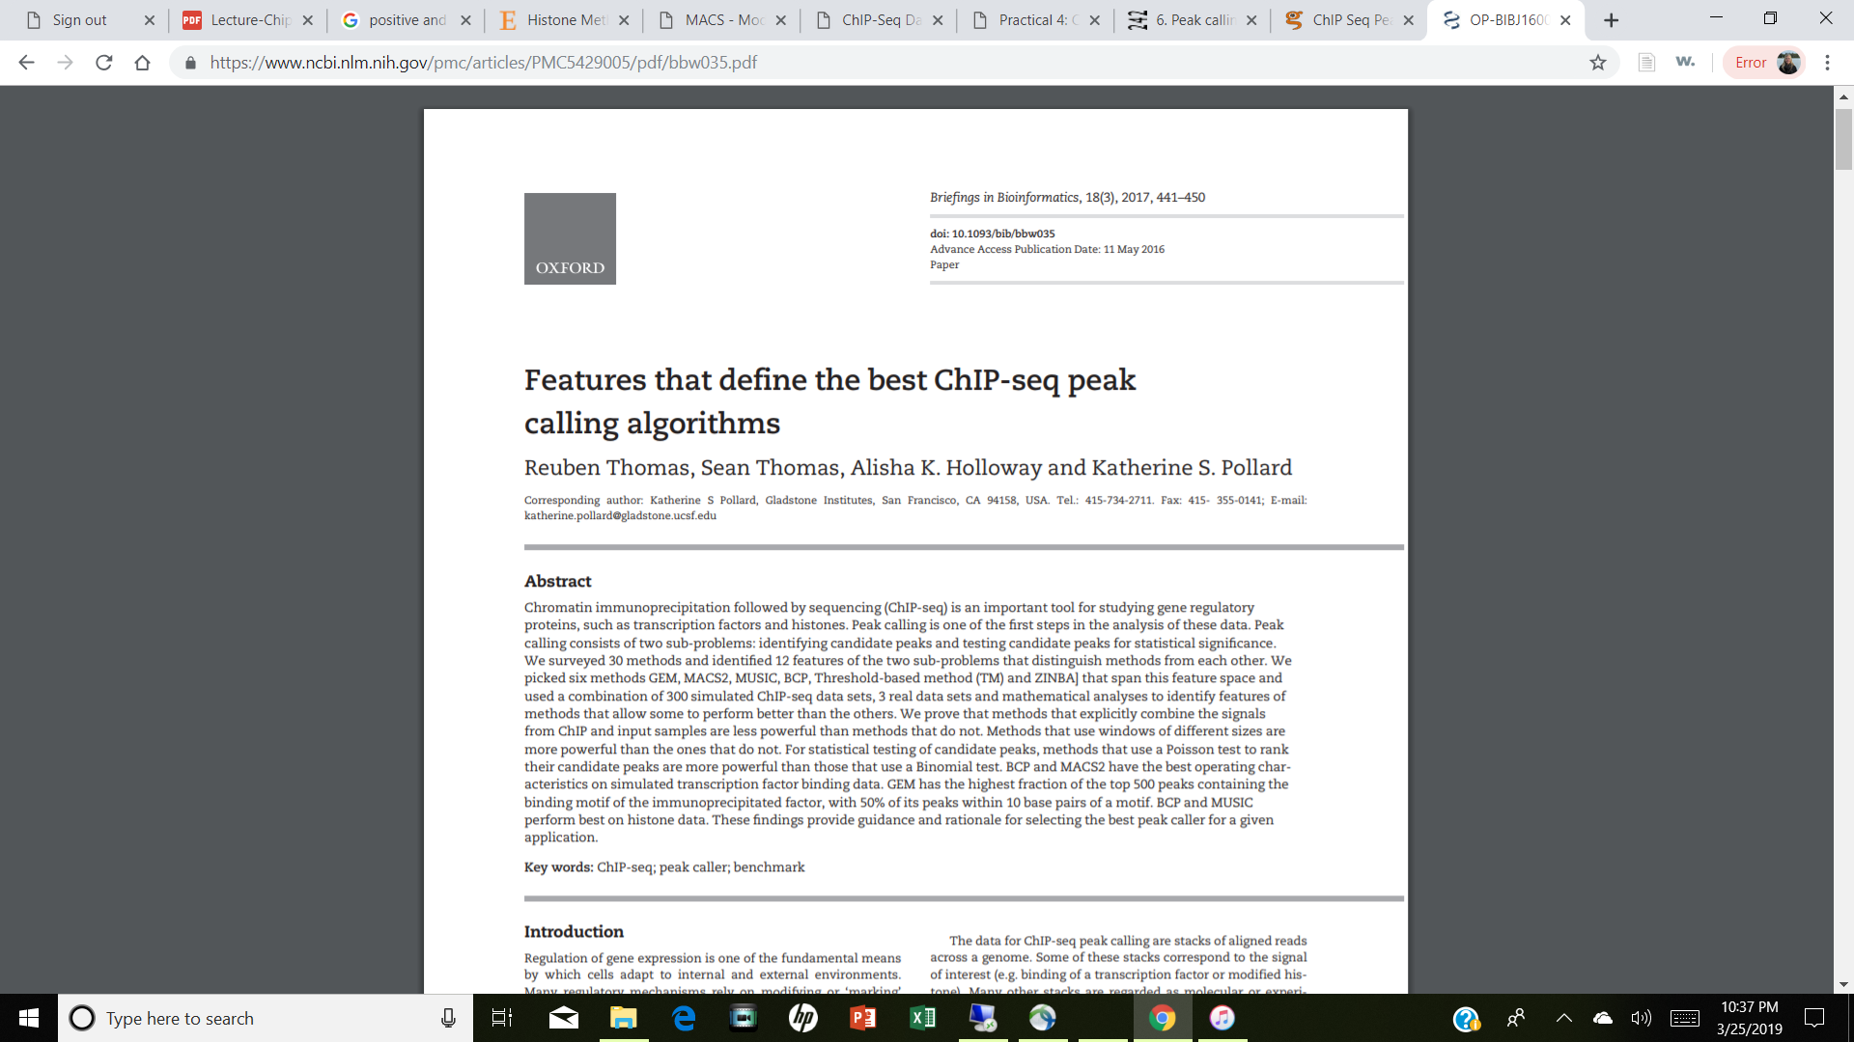
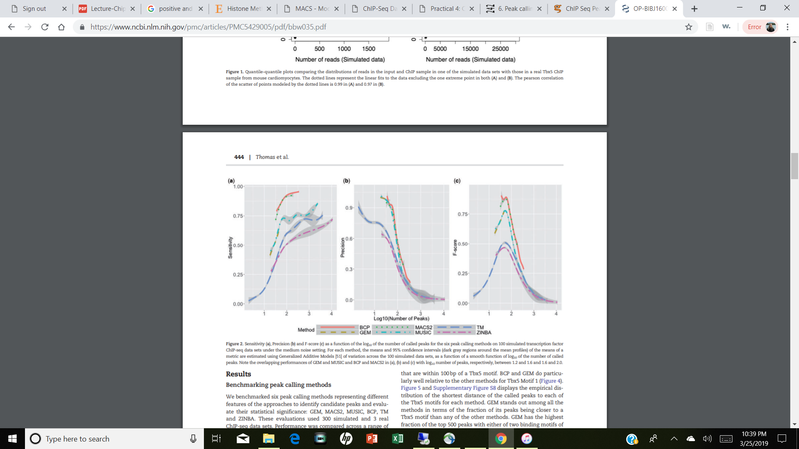
New Recommendations
Poisson test to rank their candidate peaks are more powerful than those that use a Binomial test
Best for TF:
BCP and MACS2
Best for Histones:
BCP and MUSIC

Slide 27
MACS/MACS2
Removes redundant reads
Detects read length automatically
Filters duplicates
Calculates max # duplicate reads in single positions warranted by sequencing depth, removes excess of this number
Accounts for read-shifting for the offset in forward or reverse strand reads
Models distance between paired forward and reverse strand peaks
Slides window across genome to find enriched regions (M-fold > background)
Size bandwidth is 2x bandwidth parameter (can opt for a broad option for histones)
Expected background # reads*length/mappable genome size
Peak Detection Phase
Extends reads in 3’ direction to the fragment length from modeling
Scales samples linearly to same read number of control/input
Scans genome again window size 2x fragment length
P-value from dynamic Poisson distribution capture local biases and read background levels
Benjamini-Hochberg FDR correction

Slide 28
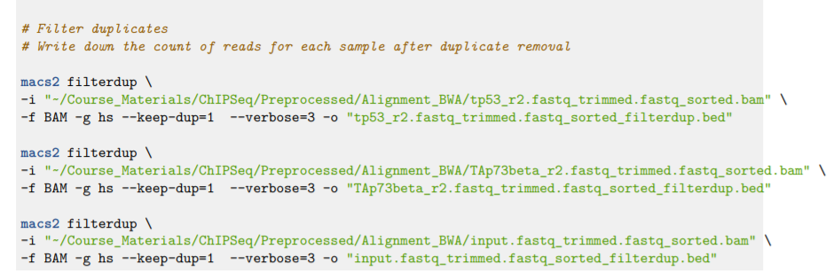
MACS2 Code
-i input file
-f format of input file
-g genome you aligned to
--keep-dup number of duplicates to keep
-o output file
Filter duplicates for each bam file

Slide 29
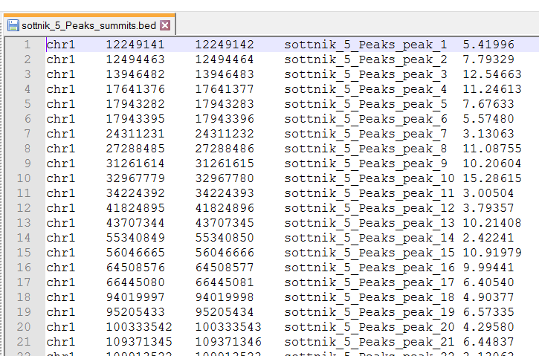
BED File Format
Tab delimited file
No Column Headers
First 3 columns required
Column 1 | Chromosome
Column 2 | Start (bp)
Column 3 | End (bp)
Column 4 | Name
Column 5 | Score
Column 6 | Strand

Slide 30
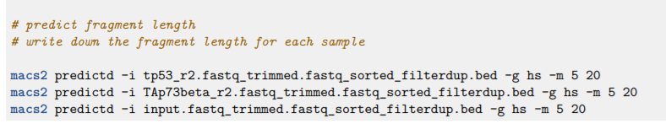
MACS2 Code
-i input file
-g genome you aligned to
-m M-FOLD Range to look at (default is 5 – 50)
-bw bandwidth of region used to compute fragment size (default 300)
Predict Fragment Length

Slide 31
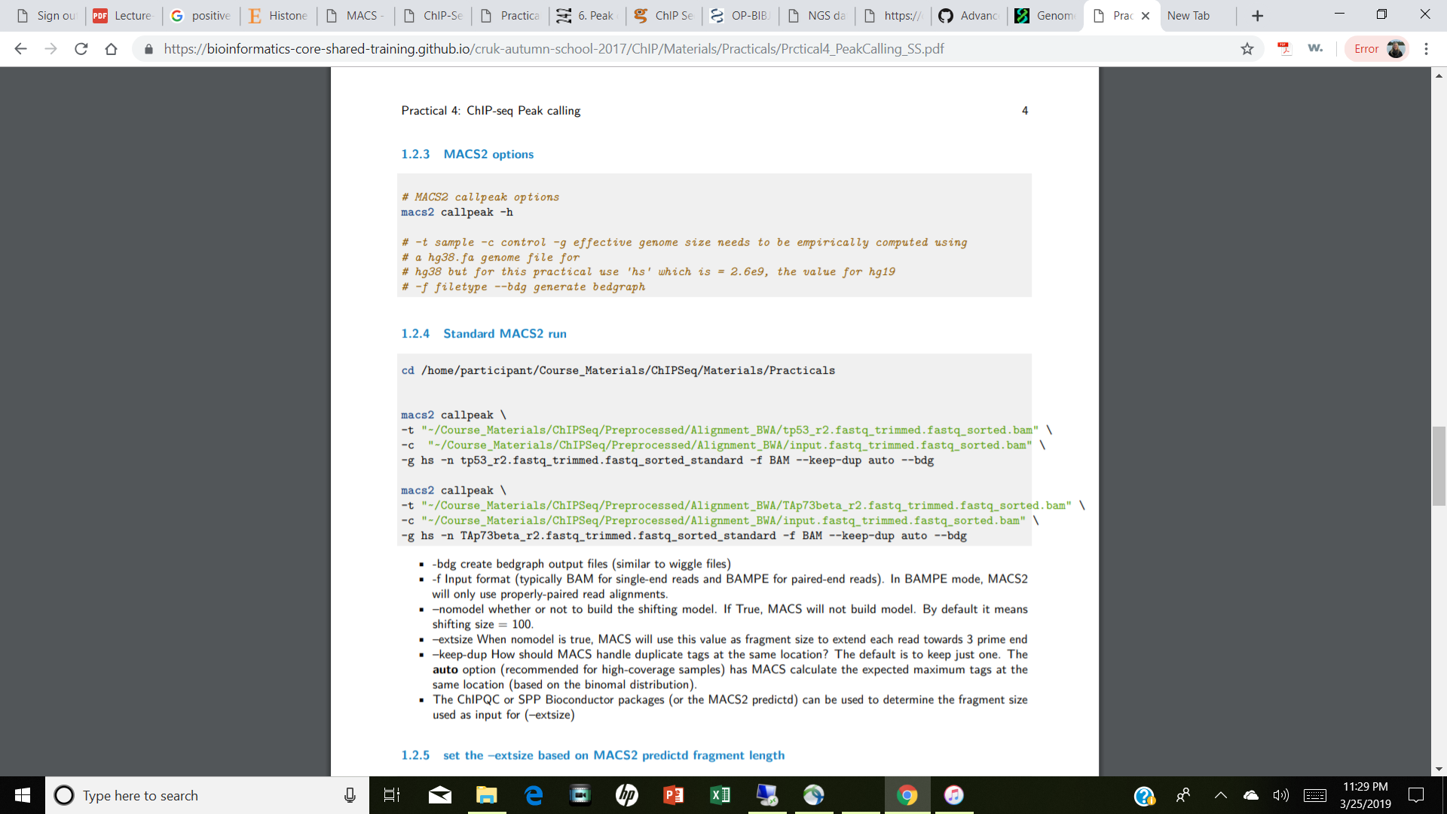
MACS2 Code
-t ChIP file
-c control/input file
-n names to generate output
--broad look for broad peaks (histones)
--bgd generate bedgraph files

Slide 32
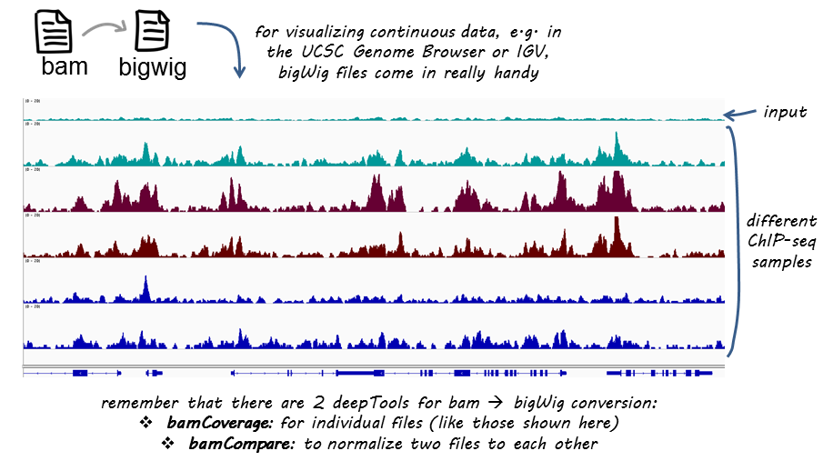
Bedgraph & BigWig Files
For visualization specifically in the genome browser
deeptools
samtools
Provide good options for going back and forth between file formats

Slide 33
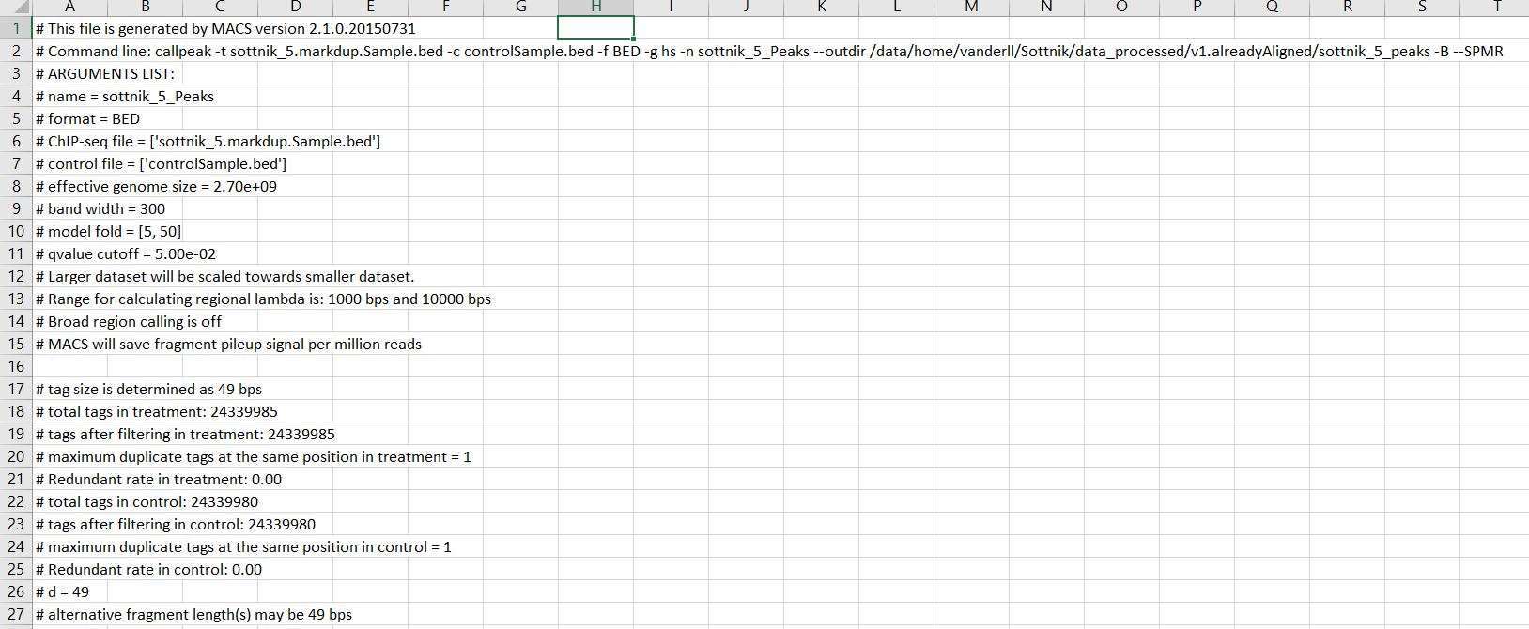
MAC2 Output

Slide 34
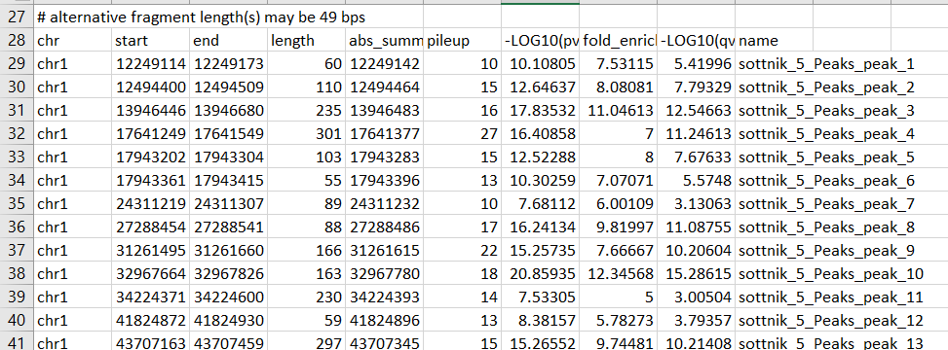
MACS2 Output
-log10(p-value)
-log10(q-value)
Absolute summit
Fold Enrichment

Slide 35
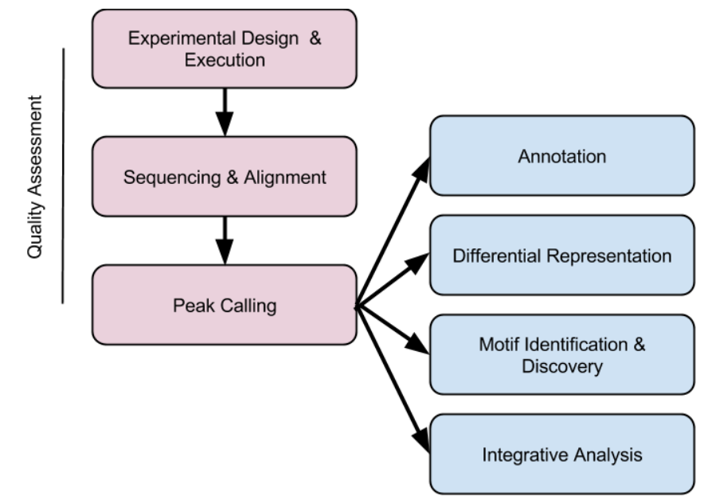
Analyses with Peaks

Slide 36
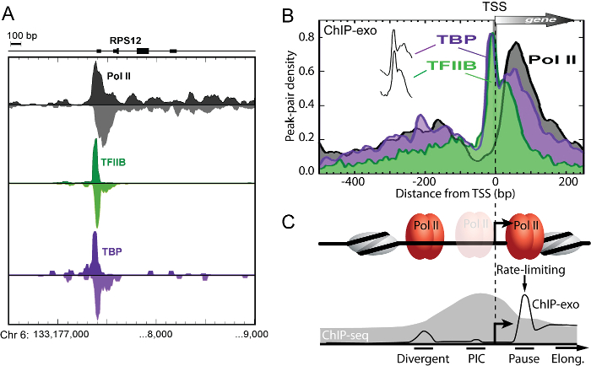
Peak Annotation
Is my peak in an gene?
What about promoter region?
Enhancer region?
Could just look at the nearest gene and calculate distance from gene
R/ChIPseeker helps annotate peaks
Source: Perreault et al, 2016

Slide 37
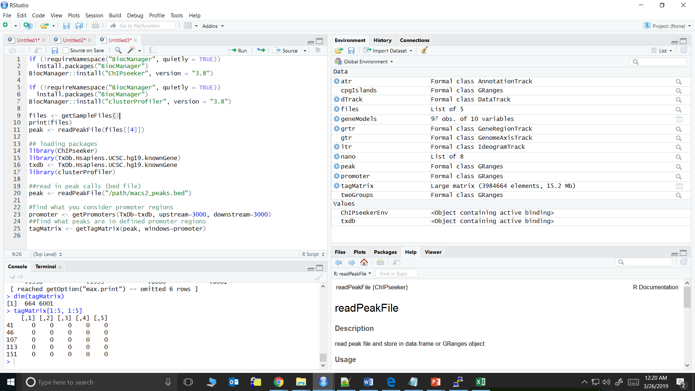
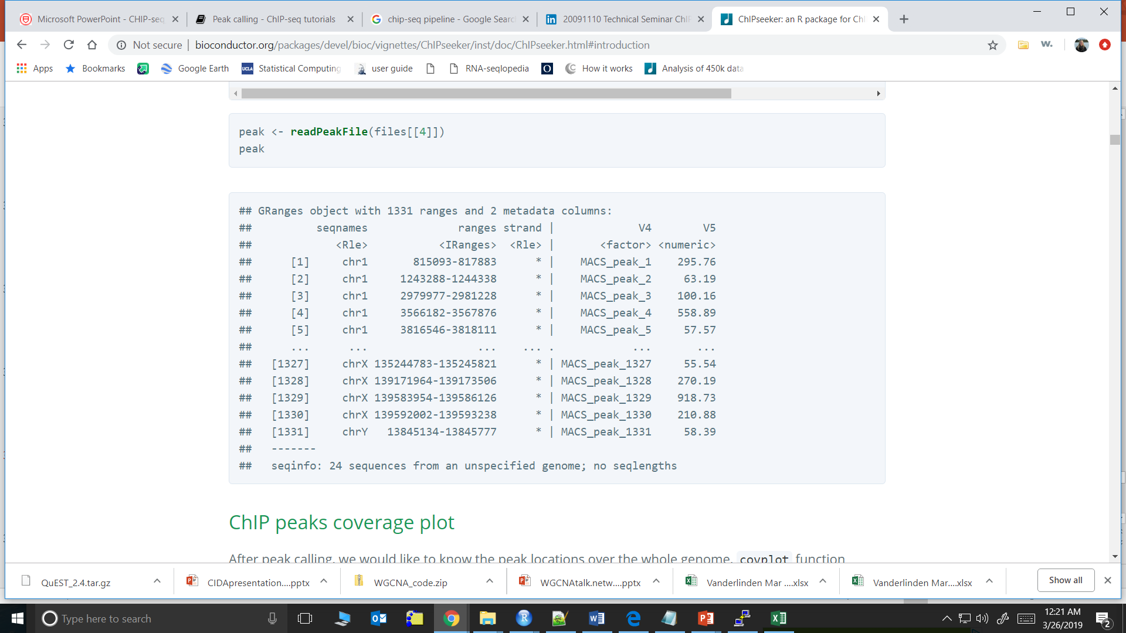
ChIPseeker Code
peak is a GRanges object,
which is a type of S4 object

Slide 38
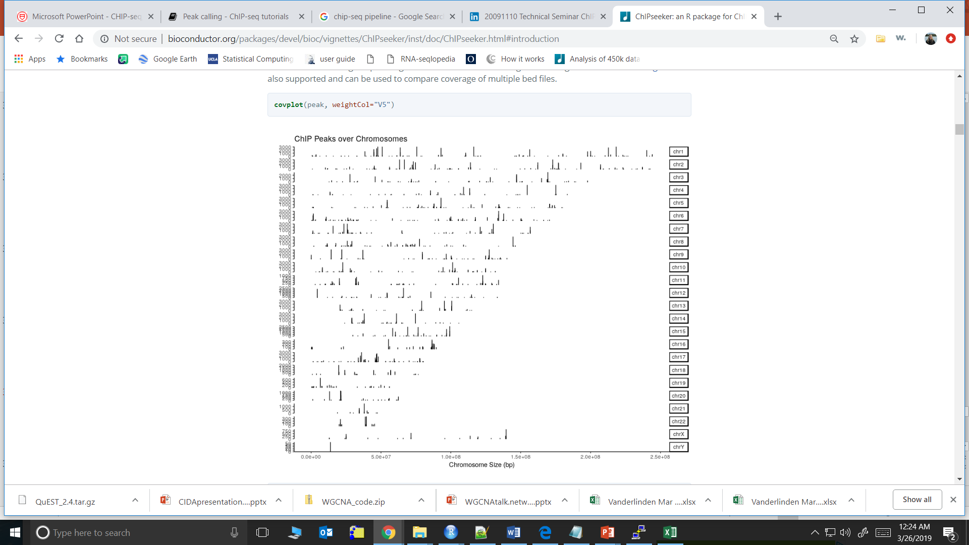
ChIPseeker Code – coverage plot

Slide 39
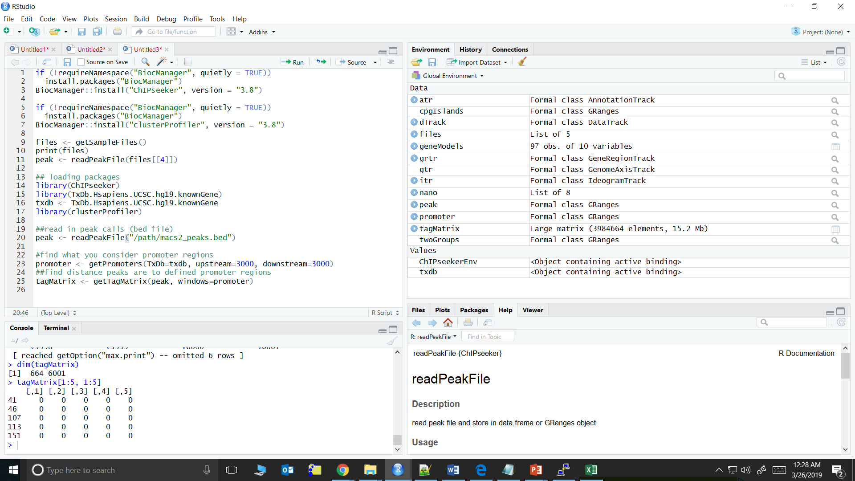
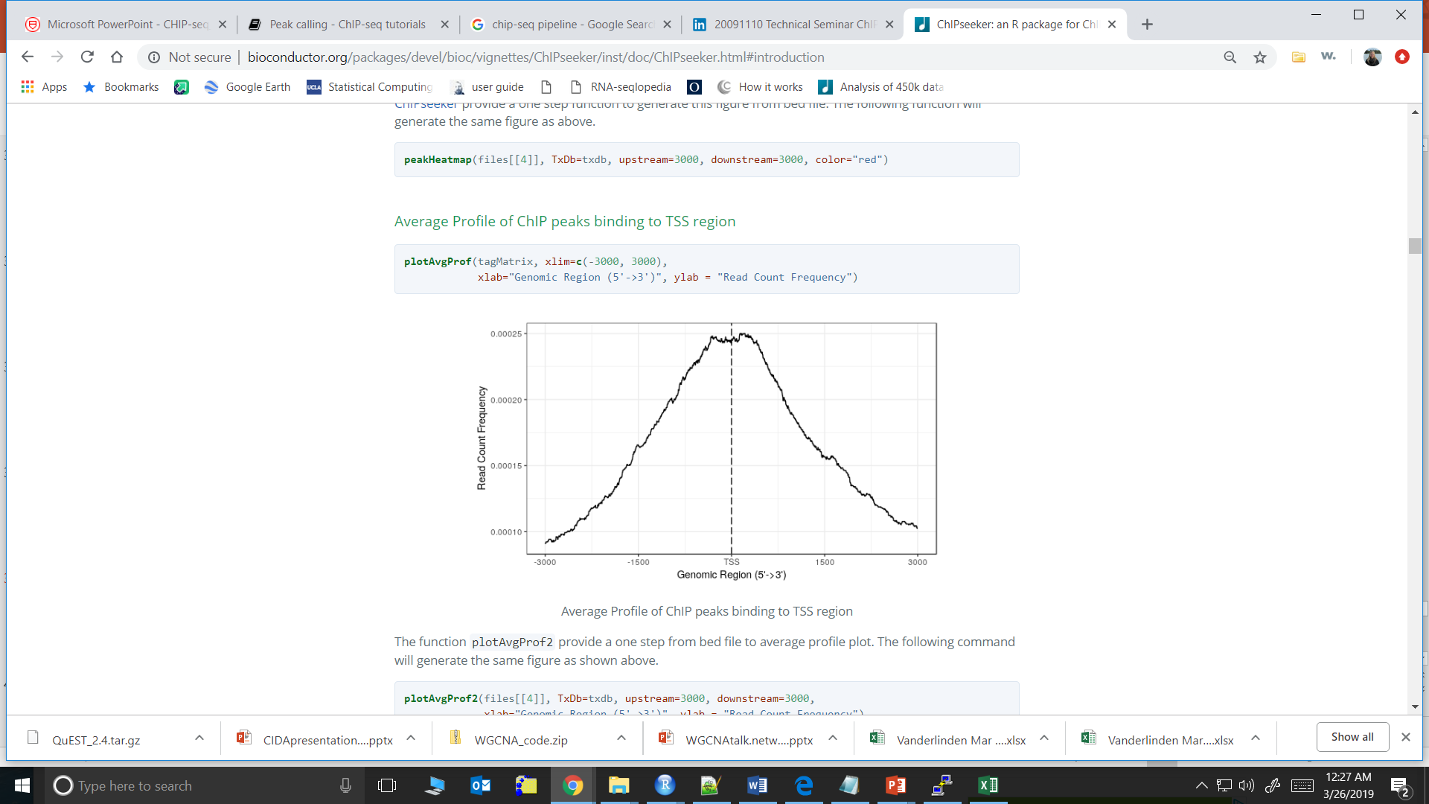
ChIPseeker Code – TSS Distance Code

Slide 40
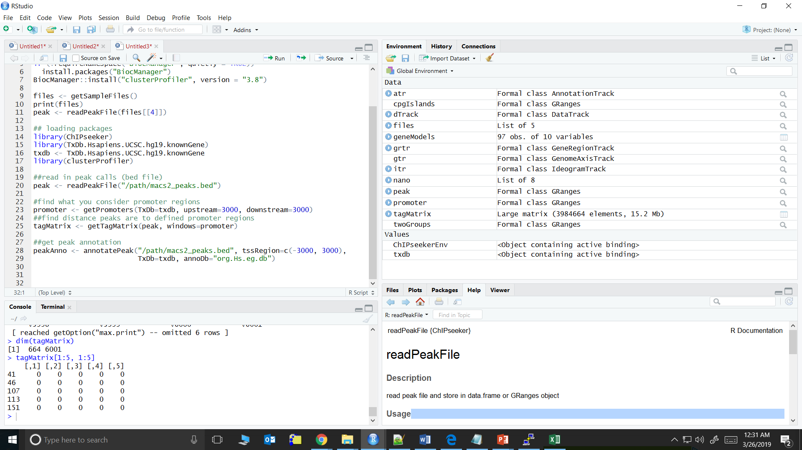
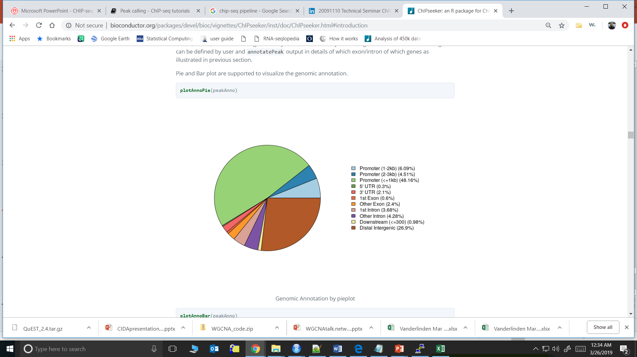
ChIPseeker Code – Peak Annotation

Slide 41
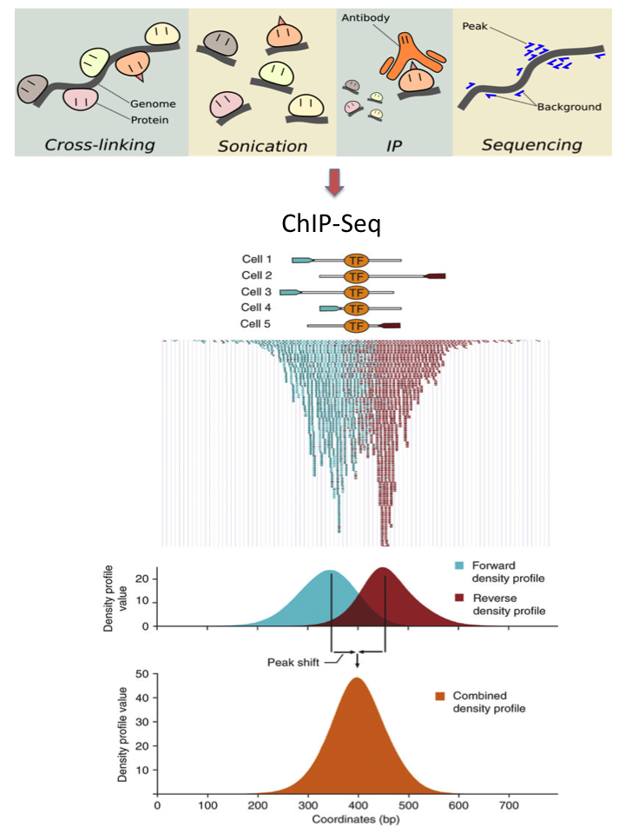
Summary
Use chromatin immunoprecipitation to extract DNA fragments which bind to protein of interest
Make peak calls
Annotate peak calls

Slide 42
References
Dressler GR, Epigenetics, Development, and the Kidney. JASN November 2008, 19 (11) 2060-2067
Shen C, Ding Y, Tang J, Song J, Guo F. Identification of DNA-protein Binding Sites through Multi-Scale Local Average Blocks on Sequence Information. Molecules. 2017 Nov 28;22(12)
Wilbanks EG, Facciotti MT. Evaluation of algorithm performance in ChIP-seq peak detection. PLoS One 2010, vol. 5 pg. e11471
Park PJ. ChIP–seq: advantages and challenges of a maturing technology. Nature Reviews Genetics 2009 volume 10, pages 669–680.
Jung, Y. L. et al. Impact of sequencing depth in ChIP–seq experiments. Nucleic Acids Res. 42, e74 (2014).
T. Bailey, P. Krajewski, I. Ladunga, C. Lefebvre, Q. Li, T. Liu, P. Madrigal, C. Taslim, J. Zhang. Practical guidelines for the comprehensive analysis of ChIP-seq data. PLoS Comput. Biol., 9 (2013), p. e1003326

Slide 43
References Continued
Xu H, Handoko L, Wei X, Ye C, Sheng J, Wei C, Lin F, Sung W: A signal–noise model for significance analysis of ChIP-seq with negative control. Bioinformatics 2010, 26(9):1199–1204.
Perreault AA, Venters BJ. The ChIP-exo Method: Identifying Protein-DNA Interactions with Near Base Pair Precision. J Vis Exp. 2016 Dec 23;(118). doi: 10.3791/55016.
https://www.youtube.com/watch?v=nkWGmaYRues
https://biohpc.cornell.edu/lab/doc/Chip-seq_workshop_lecture1.pdf
https://bioinformatics-core-shared-training.github.io/cruk-autumn-school-2017/ChIP/Materials/Practicals/Prctical4_PeakCalling_SS.pdf

